Slide 1


Accessory Dwelling Units
What you need to know
Presented by
Dave Coyne
Booth 711

Slide 2





Why are you here?

Slide 3
What’s up with ADUs?
Why are we hearing so much about them now?
What is an ADU?
What might an ADU do for you?
What are some common questions?

Slide 4
Why are we hearing so much about them now?
On Aug. 6, 2024, Governor Healey signed the Affordable Homes Act into law (Chapter 150 of the Acts of 2024).
Authorized $5.16 billion in spending over five years along with nearly 50 policy initiatives to counter rising housing costs and the severe housing shortage in Massachusetts.
Section 8 of the Affordable Homes Act amends the Zoning Act to allow ADUs to be built by right in single-family zoning districts.
The Healey-Driscoll Administration estimates that between 8,000 and 10,000 ADUs will be built across the state over the next five years due to passage of the law.

Slide 5
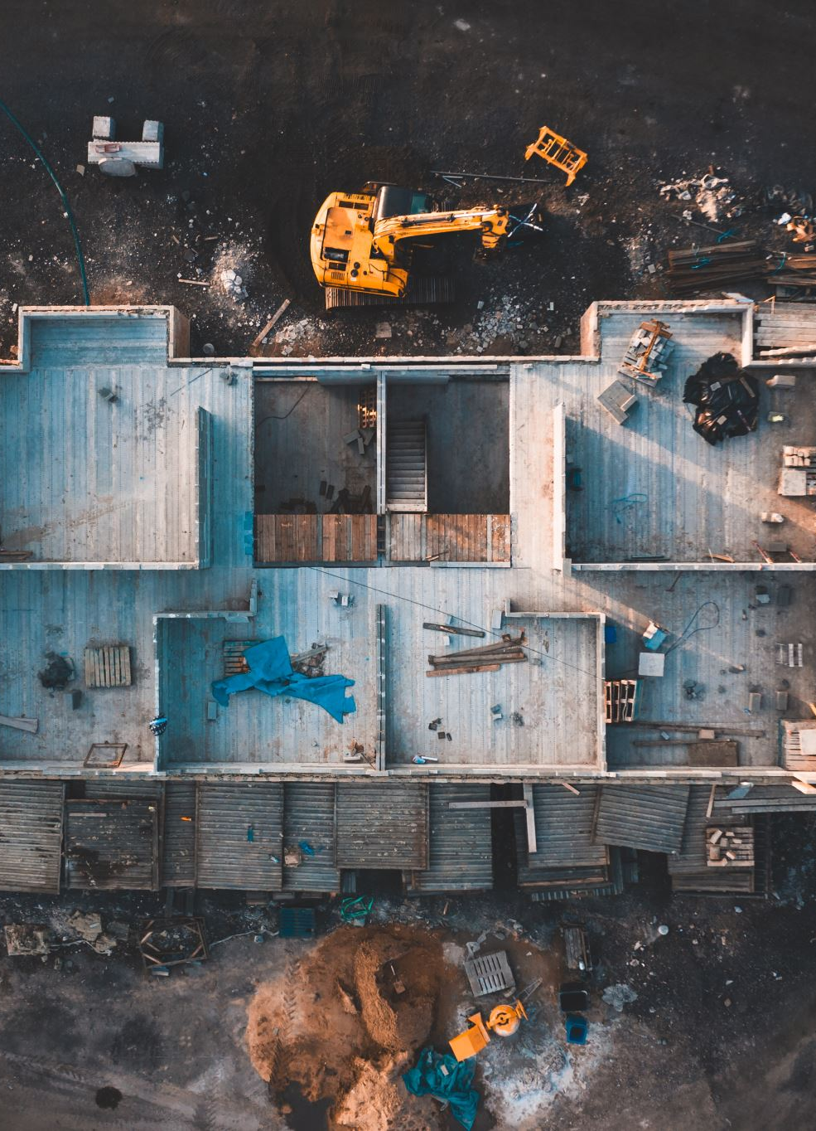
Replaces patchwork of zoning regulations with a uniform law that
Allows homeowners on single-family lots to add small units without needing special permit or variance (unless they want to add more than one)

Slide 6
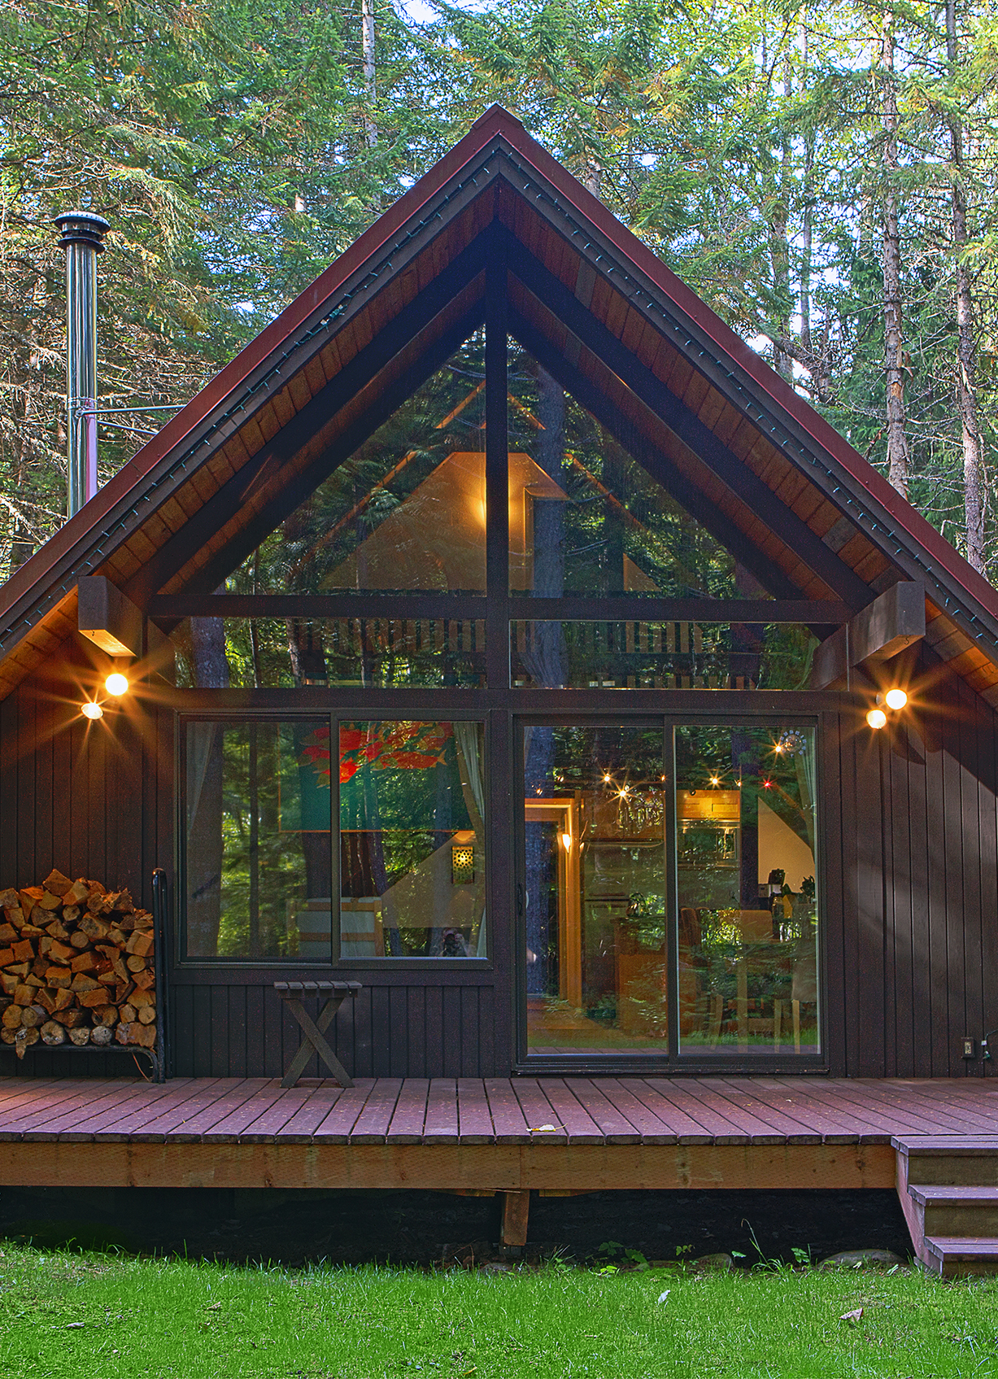
Takes the decision on ADUs away from local zoning
Effectively makes single family lots into double occupancy (space allowing)

Slide 7
What is an ADU?
Mass. General Laws c.40A § 1A
“Accessory dwelling unit”, a self-contained housing unit, inclusive of sleeping, cooking and sanitary facilities on the same lot as a principal dwelling, subject to otherwise applicable dimensional and parking requirements, that: (i) maintains a separate entrance, either directly from the outside or through an entry hall or corridor shared with the principal dwelling sufficient to meet the requirements of the state building code for safe egress; (ii) is not larger in gross floor area than 1/2 the gross floor area of the principal dwelling or 900 square feet, whichever is smaller; and (iii) is subject to such additional restrictions as may be imposed by a municipality, including, but not limited to, additional size restrictions and restrictions or prohibitions on short-term rental, as defined in section 1 of chapter 64G; provided, however, that no municipality shall unreasonably restrict the creation or rental of an accessory dwelling unit that is not a short-term rental.

Slide 8
What is an ADU? (In English!)
An Accessory Dwelling Unit is a small residential living space located on the same lot as another home. (They’ve been around for a long time, actually: granny flat, in-law apt, carriage house)
It has its own cooking, sleeping, and bathroom spaces
It may be within the main house (attic, basement, addition) or may be in a separate, small building (shed-cottage or tiny home)
It must have its own door to the exterior or to a shared common room with the main house (mudroom or hallway)

Slide 9
What is an ADU? (In English!)
It may be up to 900 SF or half the gross floor area of the main house (whichever is smaller). Gross floor area = listed square footage
It CAN share utilities with the main dwelling
It CAN be used for long-term or short-term rental provided your town doesn’t restrict all short-term rentals
It still has to conform to state and local building codes (setbacks, coverage, height, egress)

Slide 10
Considerations
Municipalities may impose their own design and size restrictions (e.g., historical commission, lot coverage, parking)
Towns can NOT require more than one parking space if more than ½ mile from public transportation
Towns can NOT require a space at all if the ADU is within ½ mile of public transportation
Adding a bedroom on a septic system? Title V still applies!
Towns may allow more than one ADU

Slide 11

What might an ADU do for you?
?

Slide 12
ADU Uses and Benefits
Make money! Provide rental income for property owners
Offers low-cost housing opportunity for adult children and other relatives to remain in their community (although occupants of the ADU do not have to be related to the property owner)
Enables more options for older adults – either as an opportunity for caregivers to live close by or to downsize while remaining in their community
Adds smaller rental units to the housing inventory to meet the needs and budgets of smaller households
Long-term residents can stay in the neighborhood they love and know (work in)

Slide 13

Common questions

Slide 14
What does an ADU cost?
  Depending on type and size, $150,000 - $450,000 typical
  Landscape, septic, water, electrical considerations
Will my property be worth more?
  Very likely!
Will my taxes go up?
  As with any property improvement it will likely increase your evaluation and tax bill
How do I know if I have to change my septic tank and what’s that cost?
  Check Title V filing from home purchase or with town
  Expect $20k-$30k range for tank replacement

Slide 15
Is there a limit on the number of bedrooms?
  Only limited by the size (70 SF min) that will fit and septic tank limitations (if any)
What’s the difference between an addition and an ADU?
  ADU may be an addition, but not all additions can be ADUs and additions can be larger
  ADU may require additional fire protection from main dwelling
What if I build an addition or a freestanding structure bigger than 900 SF with the elements of an ADU?
  It would be considered 2-family and require appropriate zoning
What’s the difference between a 2-family home and an ADU?
  Lot must be zoned for 2-family
  ADUs can be built without changing the zoning designation
  2-family dwellings have some different code requirements
  Most towns are treating ADUs like a 2-family regarding fire separation

Slide 16
Additional Resources
EOHLC: https://www.mass.gov/info-details/accessory-dwelling-units
Affordable Homes Act: malegislature.gov/Laws/SessionLaws/Acts/2024/Chapter150
ADU definition:
www.mass.gov/info-details/mass-general-laws-c40a-ss-1a
780 CMR – Massachusetts building code:
www.mass.gov/massachusetts-state-building-code-780-cmr
Local building department

Slide 17
The Craftsmen Who Care!
Booth 711
HandHRemodeling.com
(413) 382-7837
Dave@handhremodeling.com
Facebook.com/HomeandHearthRemodeling

